Slide 1
Somethings never change
Shark tank
Camilo Casas cediel 9a

Slide 2
Objective
The theme I would be based on is on family tradition
The objective of this project is to do a personal archive which shows how through the pass of the years different things changes and evolutes but that they are traditions that not even the past of the years can change or end..

Slide 3
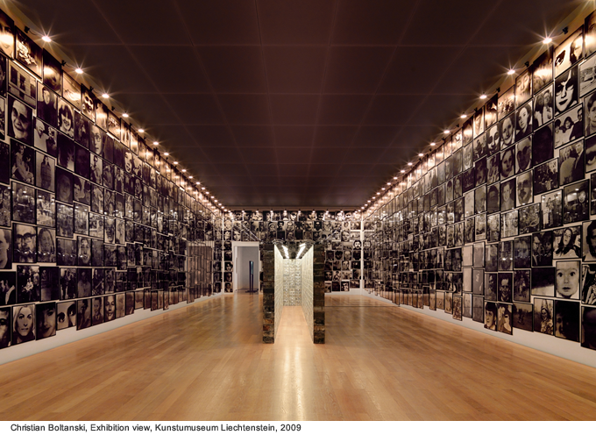
References
My main reference is Christian Boltanski
Concept: shows a choral narrative addressing individual and collective memory, entwining the past with the present, urging unattended promises, recombining history with everyone's life.
Aesthetic characteristics:
Images
Light

Slide 4
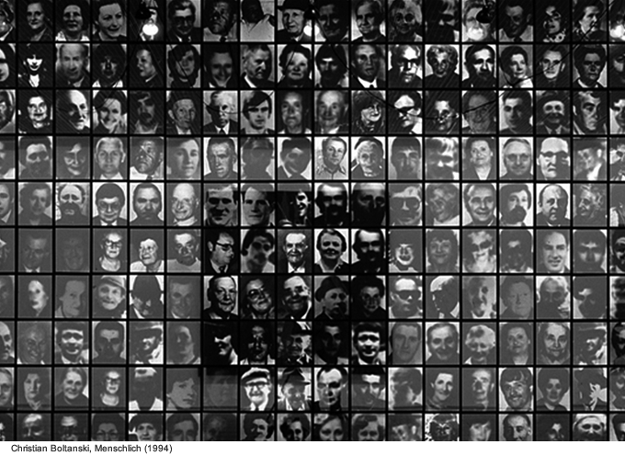
References
Christian Boltanski
Concept: shows in this a concept which emphasize in the human transience.
Aesthetic characteristics:
Image of photographers
Use of being one lighter than. other

Slide 5
Proposal
To reach the objective previously proposed about this archive what I would do will be the following:
First, I will collect the collection of cameras that many years my family have been saving. By this I would show the pass of the years and the evolution of things
Second, I would collect the photo albums which are a family tradition
Third, I would join as the cameras and album for showing how even though times changes somo thing keep being the same.
Finally, I would connect the ideas by using as seen in the experimentations in key words and connect by thread de different concepts and making the shape for the final meaning
This would be organizing by a timeline showing how things been changing

Slide 6
Sketch

Slide 7
Materials
Cameras
Albums
Big white carboard
Thread
Markers

Slide 8
Why you should buy my piece?
You should nuy my piece because through this archive you can reflecto on how important is to keep your traditons even though some things changes.
Also, you should buy my piece because through this one you can see how during the past year and decades many things have change but some things stay as the camera, photography, albums, etc.
Finally, I want ech of you to ask yourself which is your tradition?

