Slide 1
Recording studio and DAWS
Jose Fernando Florez, Pablo Carvajal, Camilo Casas, Emilio Gómez

Slide 2
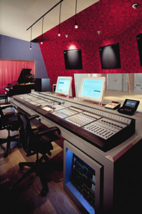
Recording studio
A recording studio is a specialized facility for recording, mixing, and audio production. It may vary in size, from a room of one person to a one being able to sustain 100. Its spaces are designed by an acoustician or audio engineer to achieve optimum acoustic properties. They are normally used to record the voice and instruments.

Slide 3
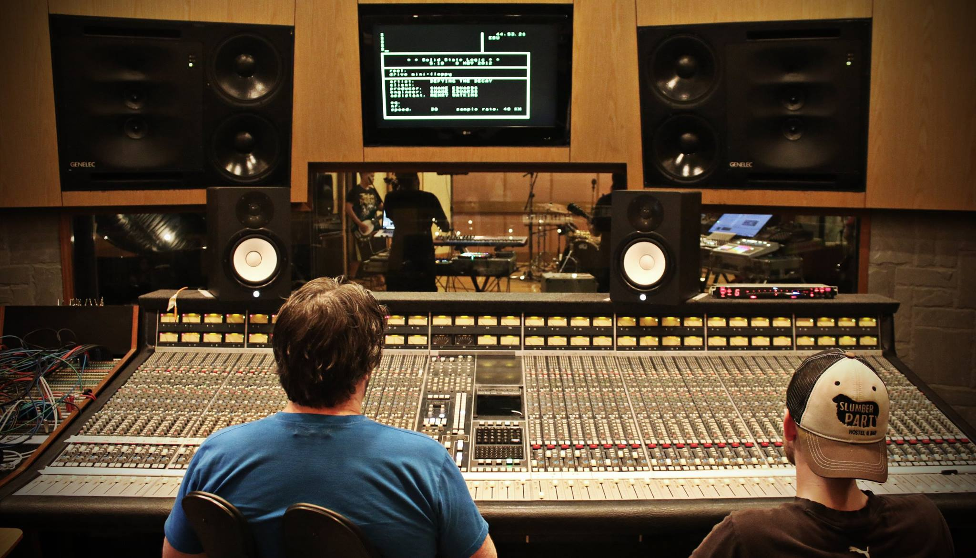
Composition of a recording studio
It has a room called live room or studio, this place is where the musicians perform, it has microphones and mic stands. The other room is the control room, this is where the sound engineers and sometimes the producers stay. In this place they have the computers and the professional audio mixing consoles to manipulate the sound and modify it. In some cases there is a room called isolation booths where the big and loud instruments are placed.

Slide 4
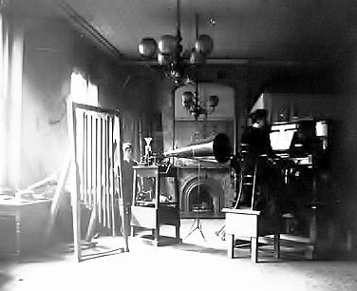
History of recording studio
The first- ever recording studio was set up in 1889 by the New York Phonograph Company.
Two decades later several professional recording studios began setting up around the world.
During the time, recording studios are evolving, adding new elements in order to improve the recording.
Finally, recording studios have plenty of uses, but mostly are used for recording music and vocals.

Slide 5
Video of evolution
https://youtu.be/Xa3Bmj-aLPM

Slide 6
What is daws?
- A digital audio workstation (DAW) is an electronic device or application software used for recording, editing and producing audio files.
- DAWs can have a variety of configurations, because it can transform from a single software rogram in a simple laptop to an all tha way highly complex configuration of numerous controlled by a computer
- But without taking into account the configguration the modern daws allows someone to alter and mix recordings and tracks for a final product.

Slide 7
What do you do with a DAW
- Digital audio processor (record, edit, and mix audio digitally
- MIDI sequencer (record, edit and mix MIDI notes)
- Virtual instruments (receives MIDI info and translates it to different instrument sounds)
- Music notation (turn MIDI notes into printable sheet music)

Slide 8
Different things you can do with DAW
There are different thing that you can do with DAW so that the sounds you use are as you whant them to be.
- You can use an audio interface with the DAW to record live instruments
-You can also record virtual instruments
-Audio looping
-Audio editing
- Audio mixing
-audio effects.

Slide 9
How does it work?
As software systems, DAWs are designed with many user interfaces, but generally, they are based on a multitrack tape recorder metaphor, making it easier for recording engineers and musicians already familiar with using tape recorders to become familiar with the new systems. Therefore, computer-based DAWs tend to have a standard layout that includes transport controls (play, rewind, record, etc.), track controls and a mixer. A waveform display is another common feature.

Slide 10
SOURCES
https://en.wikipedia.org/wiki/Digital_audio_workstation#Software_DAW
https://www.homebrewaudio.com/daw-means-digital-audio-workstation/
https://cosound.com/recording-studios/the-evolution-of-recording-studios/

