Slide 1
Recording process
Camilo casas, Emilio Gomez, Pablo Carvajal, Jose Fernando florez

Slide 2
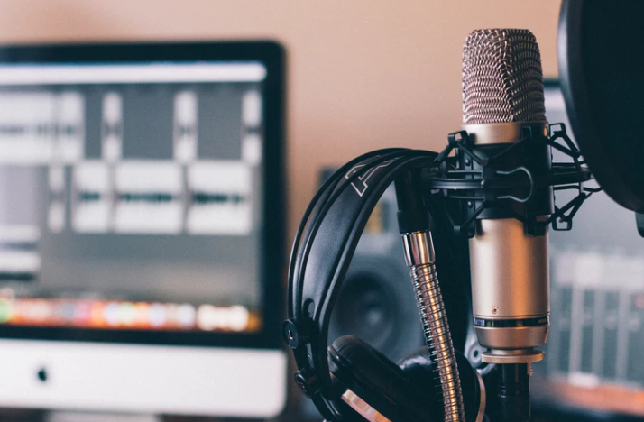
RECORDING PROCESS
The recording process is the process that a song or any music must go through. This I also, an electrical, mechanical, electronic, or digital inscription and re-creation of sound waves, such as spoken voice, singing, instrumental music, or sound effects. The two main classes of sound recording technology are analog recording and digital recording.

Slide 3
Analog audio
Analog audio is an audio that records using methods that replicates the original sound waves. It is important to know that Analog audio was born during the earliest technologies of sound and recording, also that the process of this involves using a microphone to turn air pressure or sound into electrical analog signals and imprinting them directly on analog tapes.
The main characteristics of an analog audio is that it is continuous, and it have infinite values.
The Vinyl records and the Cassette tapes belong are examples of analog audio.

Slide 4
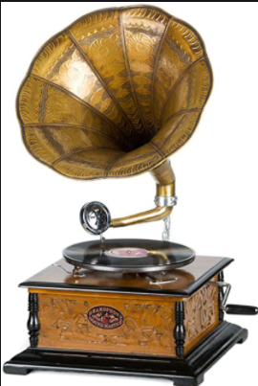
Analog recording formats
Cassette
Vinyl
Phonautograph
Gramophone
Telegraphone and Magnetaphon
Magnetic tape
https://www.youtube.com/watch?v=ugFD5HSzAvU

Slide 5
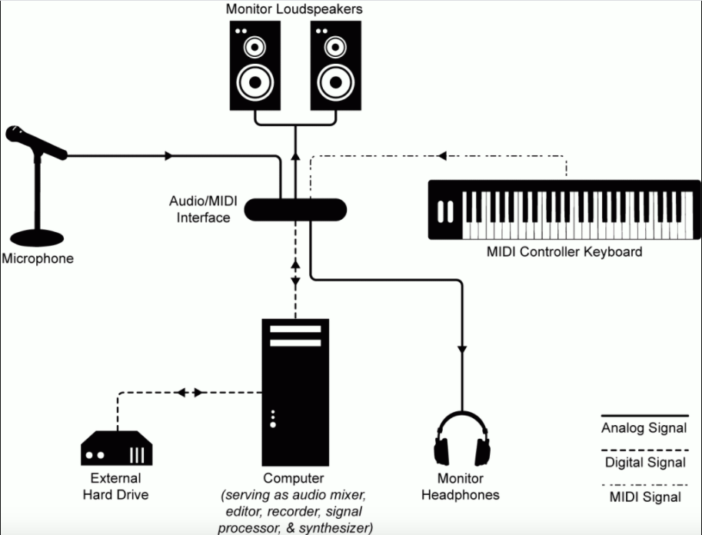
Adc /dac
ADC or analog to digital convertor is when it inputs an electrical signal like voltage or current outputs and converts it into a binary number.
The DAC or digital to analog convertor does the opposite, it uses the binary numbers and converts it in an electrical siganl like voltage.

Slide 6
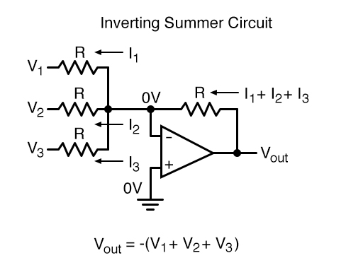
binary-weighted-input DAC
This converter works with resistors, these are the ones that have the effect of the output. The resistors need to be of equal value for the outputs to be equal, but they may be different if you want different outputs.

Slide 7
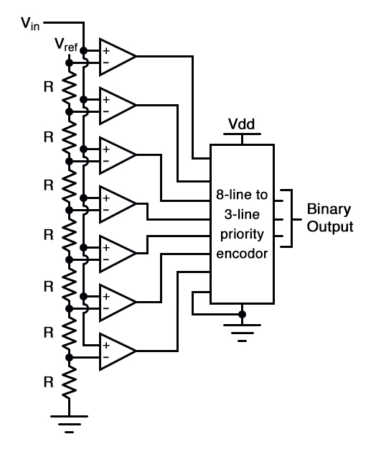
PArallel a/d converter
It has a series of comparators, that compare the input signal to a unique voltage. The comparator outputs connects to the inputs of a priority encoder (Change set signals into code) circuit. That produces a binary output.

Slide 8
Digital audio
The digital audio as well as the analog audio are often considered as steps rather than methods to an audio production.
"Interestingly, digital audio recording also requires the step of turning sound into an electric analog signal, except it extends the process to convert that analog signal into digital, or as a series of numbers that digital software (like those found in your computer or mp3 player) can read and reproduce. This digital form of audio is then easily copied onto compact disks, hard drives, or uploaded online for widespread playback." (adorama.com)

Slide 9
Digital audio
What does that mean: Digital audio is a "representation" of sound that is converted into a digital form throughout the sound waves of the audio signals that are organized as numerical samples.
One example of this are cd´s and their sample depth "bit depth is the number of bits of information in each sample, and it directly corresponds to the resolution of each sample."
What is a sample? : A sample is a digital representation of an analog signal. Both digital video and digital audio files are created using samples. ... For example, a violin sound or a bird chirp may be sampled and then played back from a digital keyboard (or synthesizer).
https://techterms.com/definition/sample#:~:text=A%20sample%20is%20a%20digital,files%20are%20created%20using%20samples.&text=For%20example%2C%20a%20violin%20sound,digital%20keyboard%20(or%20synthesizer).

Slide 10
Digital recording formats
The different digital recording formats that exist for digital audio, all have different functions or advantages
Some examples are:
.MP3, MP4 or .M4A, WMA (Windows Media Audio), OGG Ogg Vorbis, etc.
A recording format is an: is a format for encoding data for storage on a storage medium. The format can be container information such as sectors on a disk, or user/audience information (content) such as analog stereo audio. Multiple levels of encoding may be achieved in one format
http://www.theatrecrafts.com/pages/home/topics/sound/digital-audio-file-formats/

Slide 11
Bibliography in APA rules
Understanding Analog and Digital Audio. (2020). Retrieved 22 November 2020, from http://www.centerpointaudio.com/Analog-VS-Digital.aspx
Analog vs. Digital Audio: What’s the Difference? (2020). Retrieved 22 November 2020, from https://www.adorama.com/alc/analog-vs-digital-audio/
Kiem, R. (2020). Flash ADC | Digital-Analog Conversion | Electronics Textbook. Retrieved 23 November 2020, from https://www.allaboutcircuits.com/textbook/digital/chpt-13/flash-adc/
Tool, B. (2020). The R/2nR DAC: Binary-Weighted-Input Digital-to-Analog Converter | Digital-Analog Conversion | Electronics Textbook. Retrieved 23 November 2020, from https://www.allaboutcircuits.com/textbook/digital/chpt-13/r-2nr-dac

Slide 12
Bibliography
Tool, B. (2020). Flash ADC | Digital-Analog Conversion | Electronics Textbook. Retrieved 23 November 2020, from https://www.allaboutcircuits.com/textbook/digital/chpt-13/flash-adc

